Slide 1
Valentine’s Day 2014

Slide 2
How do you choose your partner?

Slide 3
How do you choose your partner?

Slide 4
I’m looking for someone!

Slide 5
Mass weddings on February 14th

Slide 6
Looking for someone to love?

Slide 7
Game show

Slide 8
When?
Traditionally, spring begins on St Valentine's Day (February 14th )
Each year in Britain, we spend around £503m on cards, flowers, chocolates and other gifts for Valentine's Day.
Traditionally these were sent anonymously, but nowadays we often make it clear who is sending each 'Valentine'.

Slide 9
Valentine cards

Slide 10
Background
Valentine's Day has been celebrated in the UK for thousands of years.
It probably began as a pre-Roman festival.There was a Roman festival called Lupercalia in the middle of February to mark the start of spring. There were a range of fertility and marriage rites associated with Lupercalia.
As Christianity spread across the Roman Empire, including much of the UK, this festival became a day of remembrance for St Valentine.
Valentine's Day became increasingly commercial during the second half of the twentieth century. This continues in the 21st century.

Slide 11
Valentine's Day Traditions
There are many traditions and tales associated with romance activities on Valentine's day including:
the first man an unmarried woman saw on 14th February would be her future husband;
if the names of all a girl's suitors were written on paper and wrapped in clay and the clay put into water, the piece that rose to the surface first would contain the name of her husband-to-be.
if a woman saw a robin flying overhead on Valentine’s Day, it meant she would marry a sailor. If she saw a sparrow, she would marry a poor man and be very happy. If she saw a goldfinch, she would marry a rich person.

Slide 12
Symbols
Valentine's Day symbols include red or pink hearts, red roses, teddy bears with roses or hearts and couples kissing or holding each other. These symbols are printed on cards, wrapping paper, lingerie and clothing.
Pictures or models of Cupid are also often displayed in the run up to and on Valentine's Day in the UK.
Cupid is usually shown as a small winged person with a bow and arrow. According to mythology, he uses his bow and arrow to strike romantic love into people's hearts.

Slide 14
Valentine’s Day flowers

Slide 15
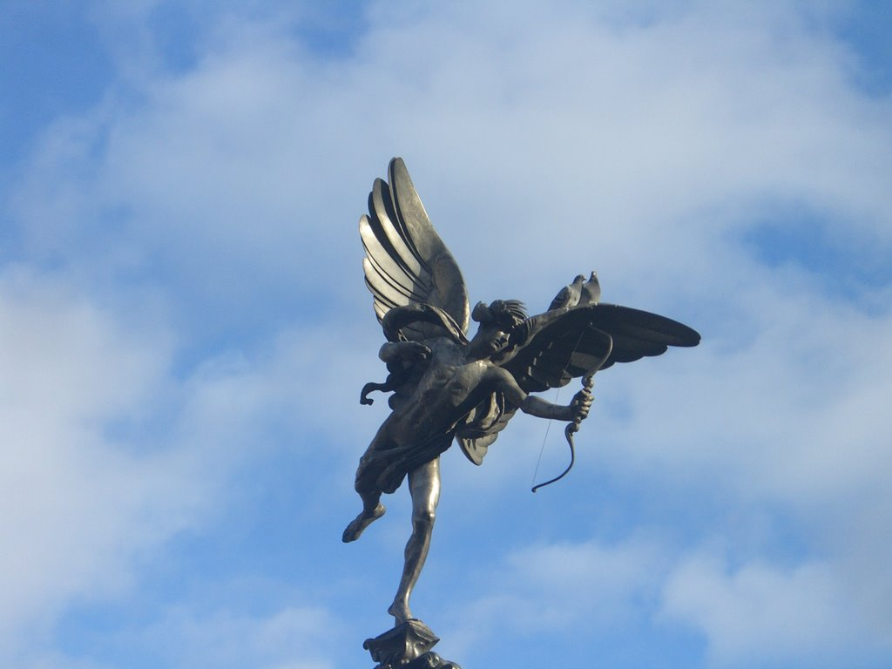
Cupid’s arrow

Slide 16
What do people do? Cards
Children, parents and other relatives send exchange Valentine's Day cards in some families. Groups of female friends may also send each other Valentine's Day cards. However, these customs are less common in the United Kingdom than in some other countries.

Slide 17
What do people do?
Many couples try to eat a special meal with each other. They may do this in a restaurant, hotel room or at home.
Some choose food and drink with a romantic feel, such as oysters, chocolate fondue, strawberries and champagne.
Others choose less formal, but easily prepared dishes.

