Slide 1
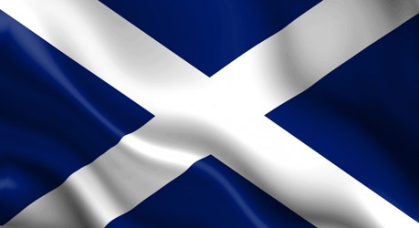
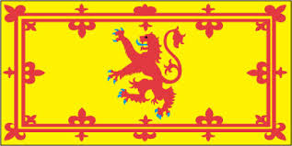

Slide 2
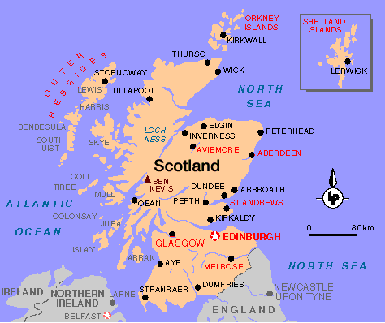

Slide 3
The Saltire
Scotland’s national flag is thought to be the oldest national flag in Europe.
Notes:
The actual word 'Saltire' means 'a cross with diagonal bars of equal length' and the national flag of Scotland is made up of a white saltire (aka St. Andrews' Cross) on a blue background. First hoisted in 1512, it's believed to be one of the oldest flags in the world still in use today.
The beloved Saltire
The use of the white saltire cross as Scottish icon/emblem dates back to the 13th and 14th Century.
It was approved as the flag/badge of the Scottish people in a statute made in 1388.
The first historical reference to the white saltire being used on the Scottish flag (albeit with a red background at that point), occurs in 1503.

Slide 4
Lion Rampant of Scotland
The Royal Banner of the Royal Arms of Scotland,
Royal Banner of Scotland,
Royal Standard of Scotland,
Banner of the King of Scots
Notes:
The 'Lion Flag' is often considered the unofficial national flag and referred to as the 'Royal Flag of Scotland'. The 'Royal' term applies because this flag historically, and legally, belongs to the monarchy (or royalty) - more specifically to a King or Queen of Scotland.
As there hasn't been a Scottish King or Queen since the 17th Century, it now belongs to Queen Elizabeth II. It's a more colourful and dramatic flag than the Saltire, and may be a little more memorable because of that.
The term 'lion rampant' actually refers to the positioning or attitude of the lion. A rampant lion is shown as a profile of a lion standing upright (on one or both hind legs) and the forelegs are raised, claws unsheathed, as if to strike.

Slide 5
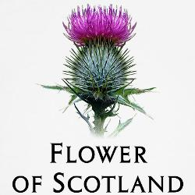
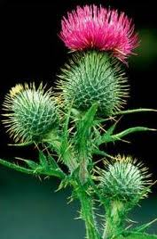
The Thistle
National Emblem of Scotland
Notes:
The prickly purple thistle was adopted as the Emblem of Scotland during the rein of Alexander III (1249 -1286). Legend has it that an Army of King Haakon of Norway, intent on conquering the Scots landed at the Coast of Largs at night to surprise the sleeping Scottish Clansmen. In order to move more stealthily under the cover of darkness the Norsemen removed their footwear. As they drew near to the Scots it wasn't the only thing hiding under the cover of darkness. For one of Haakon's men unfortunately stood on one of these spiny little defenders and shrieked out in pain, alerting the Clansmen of the advancing Norsemen. Needless to say the Scots won the day.
The first use of the Thistle as a royal symbol of Scotland was on silver coins issued by James III in 1470

Slide 6
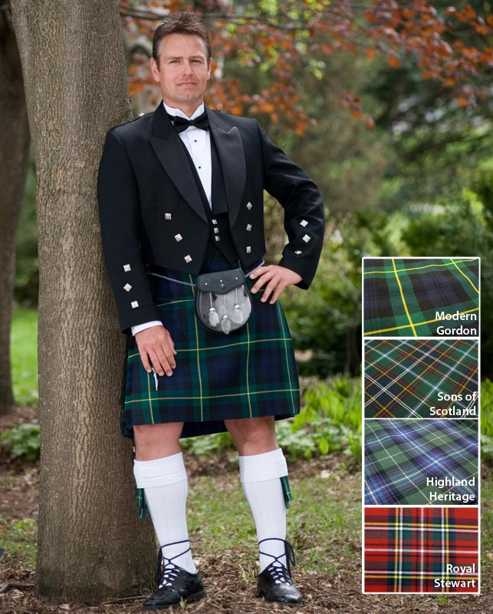
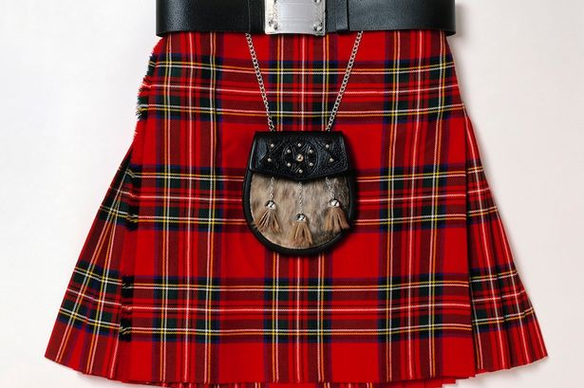
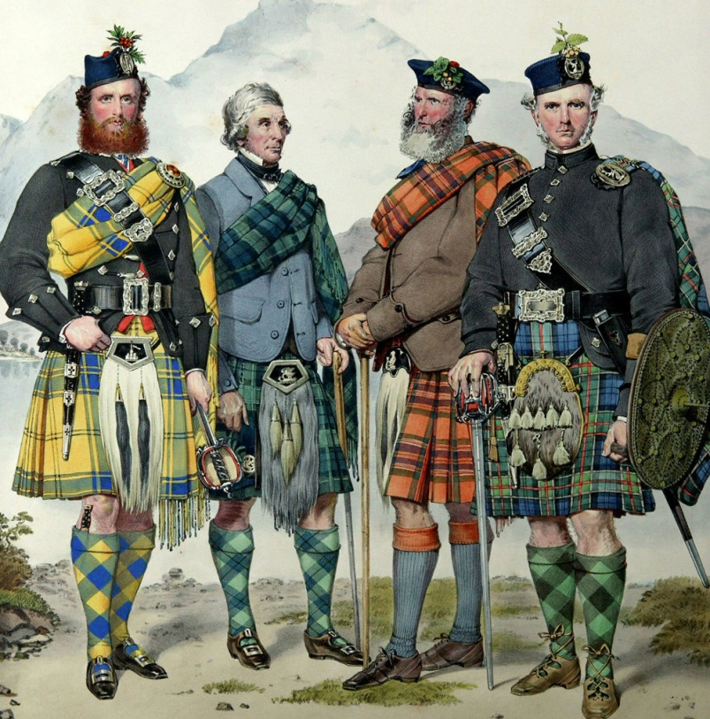
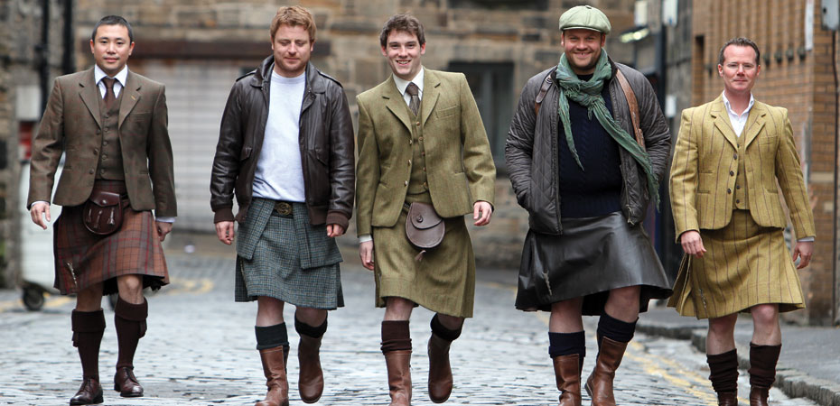
Kilts

Slide 7
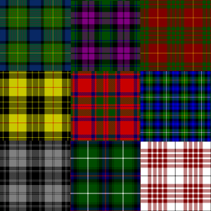
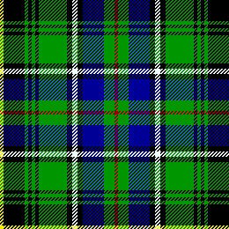
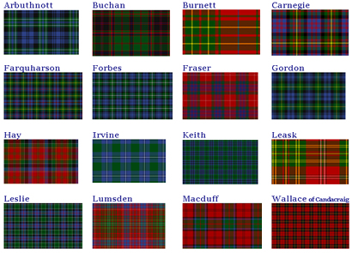
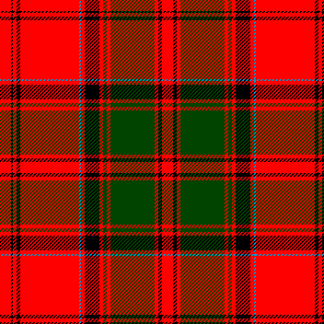
Tartan

Slide 8
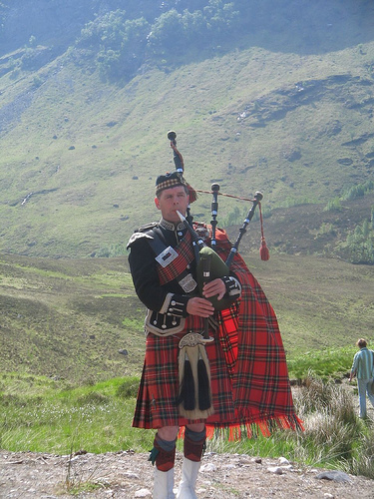
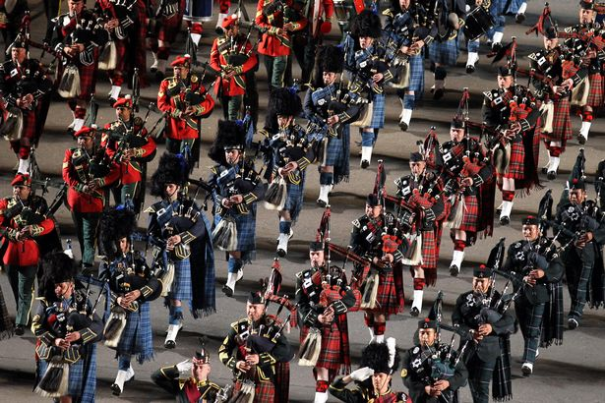
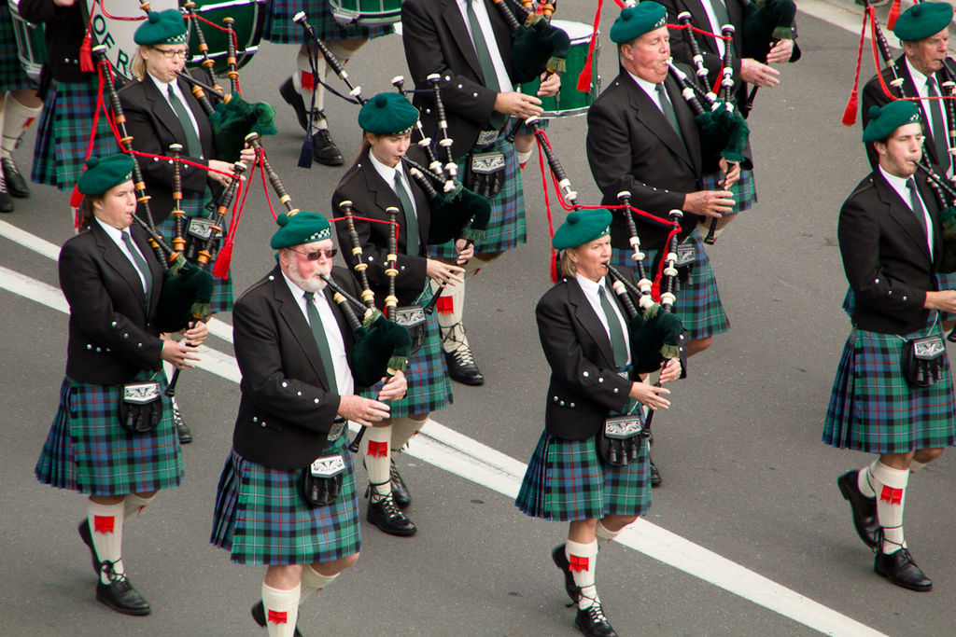
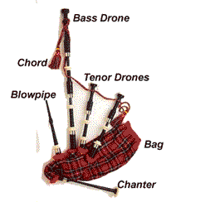
Bagpipes

Slide 9
National Celebrations
First Footing – 1 January
The "first foot" in the house after midnight should be male, dark, and handsome and should carry symbolic coal, shortbread, salt, black bun ( a spiced cake) and whisky.
Burns Night – 25 January
The anniversary of the birth of the poet Robert Burns, in 1759 at which many a "Burns Supper" is consumed.
St Andrews Day – 30 November
St Andrew has been the patron saint of Scotland since a Pictish victory in a battle in 747AD,

Slide 10
National Celebrations
Hogmanay – New Year’s Eve – 31 December
A more important festival in Scotland than Christmas. when the whole country celebrates in the build up to "the bells" chiming midnight.
There are traditions such as cleaning the house (known as "redding") on 31st December (including taking out the ashes from the fire in the days when coal fires were common). And Scotland is the only part of the UK that has a statutory holiday on 2nd January as well as 1st January - so we can recover from the excesses of 31 December!

Slide 11
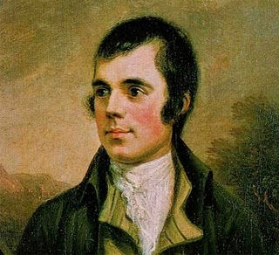
Robert Burns
National Poet of Scotland
25 January 1759 – 21 July 1796
Celebrated on 25 January each year - Burns Night
Poems include:
Tam O’Shanter
Address to a Haggis
Auld Lang Syne
A Man’s a Man for a’ that
My Luve is like a Red, Red Rose
To a mouse

Slide 12
Robert Burns
O, My Luve is Like a Red, Red Rose
O, my luve is like a red, red rose, That's newly sprung in June. O, my luve is like a melodie, That's sweetly play'd in tune.
As fair art thou, my bonie lass, So deep in luve am I, And I will luve thee still, my dear, Till a' the seas gang dry.
O, my love is like a red, red rose, That's newly sprung in June. O, my love is like a melodie, That's sweetly play'd in tune.
As fair are you, my lovely girl, So deep in love am I, And I will love you still, my dear, Until all the seas run dry.

Slide 13
Robert Burns
O, My Luve is Like a Red, Red Rose
Till a' the seas gang dry, my dear, And the rocks melt wi the sun! And I will luve thee still, my dear, While the sands o life shall run.
And fare thee weel, my only luve! And fare thee weel, a while! And I will come again, my luve, Tho it were ten thousand mile!
Until all the seas run dry, my dear, And the rocks melt with the sun! And I will love you still, my dear, While the sands of life shall run.
And farewell, my only love! And farewell, a while! And I will come again, my love, If it were ten thousand mile!

Slide 14
Scottish Songs

Slide 15
Flower of Scotland
O flower of Scotland When will we see your like again That fought and died for Your wee bit hill and glen And stood against him Proud Edward's army And sent him homeward Tae think again The hills are bare now And autumn leaves lie thick and still O'er land that is lost now Which those so dearly held And stood against him Proud Edward's army And sent him homeward Tae think again
Those days are passed now And in the past they must remain But we can still rise now And be the nation again That stood against him Proud Edward's army And sent him homeward Tae think again
O flower of Scotland When will we see your like again That fought and died for Your wee bit hill and glen And stood against him Proud Edward's army And sent him homeward Tae think again
Scotland's (unofficial) National Anthem
Notes:
While Flower of Scotland is regularly played at football and rugby grounds, athletes have instead celebrated medals with Scotland the Brave.

Slide 16
Auld Lang Syne “Old Long Ago” 'We'll take a Cup of Kindness yet' relate to a drink shared by men and women to symbolise friendship
Should old acquaintance be forgot, and never brought to mind? Should old acquaintance be forgot, For the sake of auld lang syne?
CHORUS
For auld lang syne, my dear, For auld lang syne, We'll take a cup of kindness yet, For the sake of auld lang syne
And surely you'll buy your pint cup! And surely I'll buy mine! We'll take a cup of kindness yet, For the sake of auld lang syne
CHORUS And there's a hand my trusty friend! And give me one of thine! We'll take a right good-will drink, For the sake of auld lang syne
CHORUS

Slide 17
Scottish Food and Drink

Slide 18
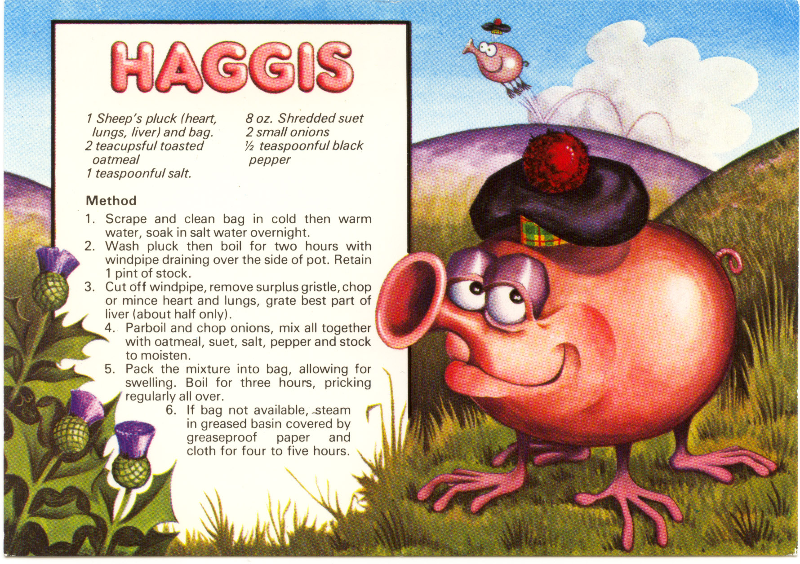

Slide 19
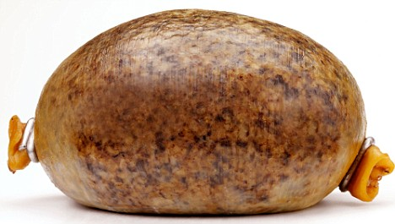
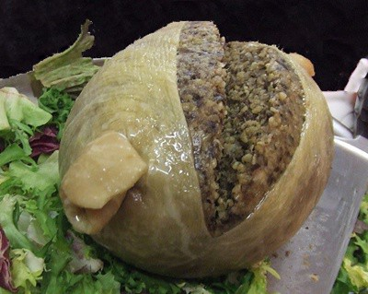
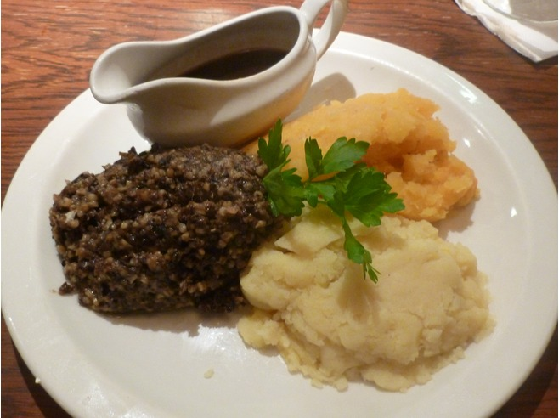
Haggis

Slide 20
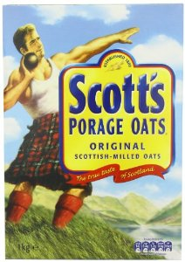
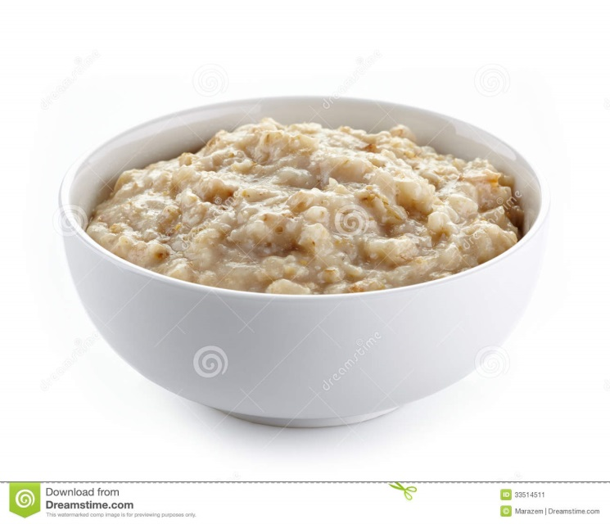
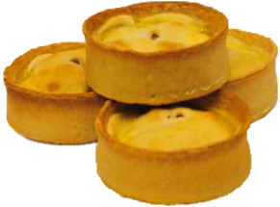
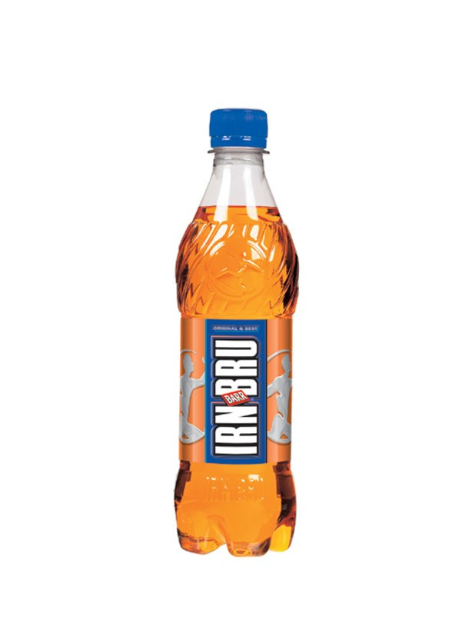
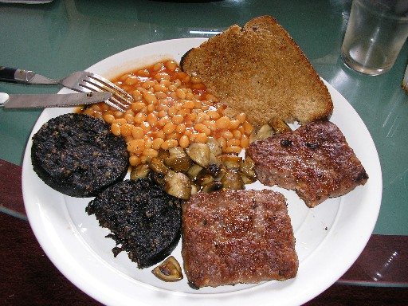
Porage Oats
Scotch Pies
Square Sausages

Slide 21
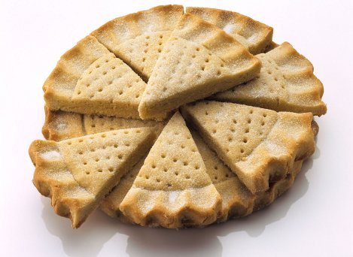
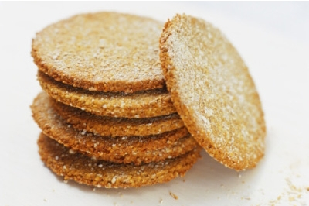
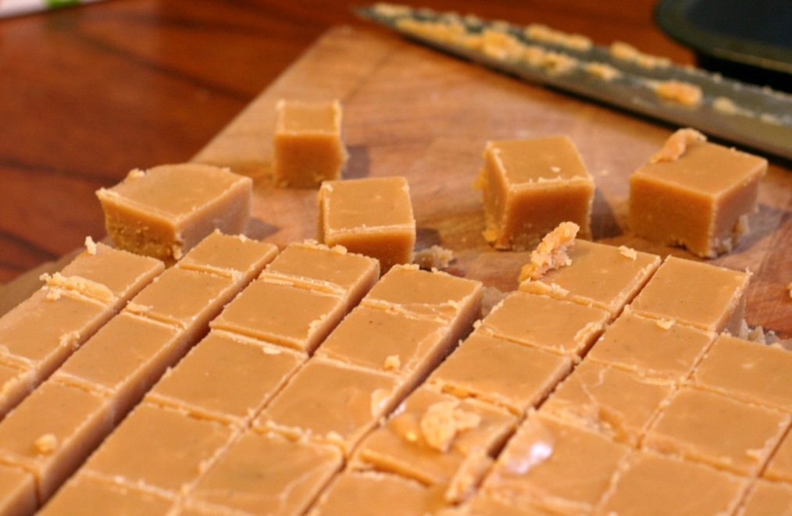
Shortbread
Oat Cakes
Scottish Tablet

Slide 22
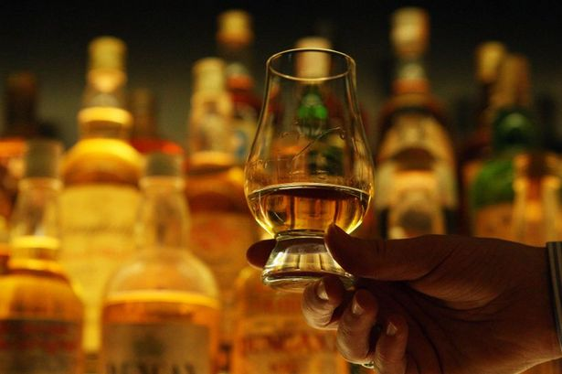
Scottish Whisky

Slide 23
Views of Scotland

Slide 24
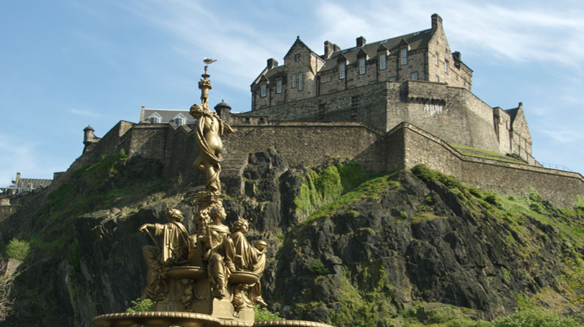
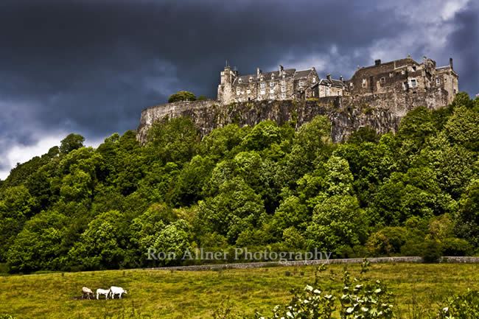
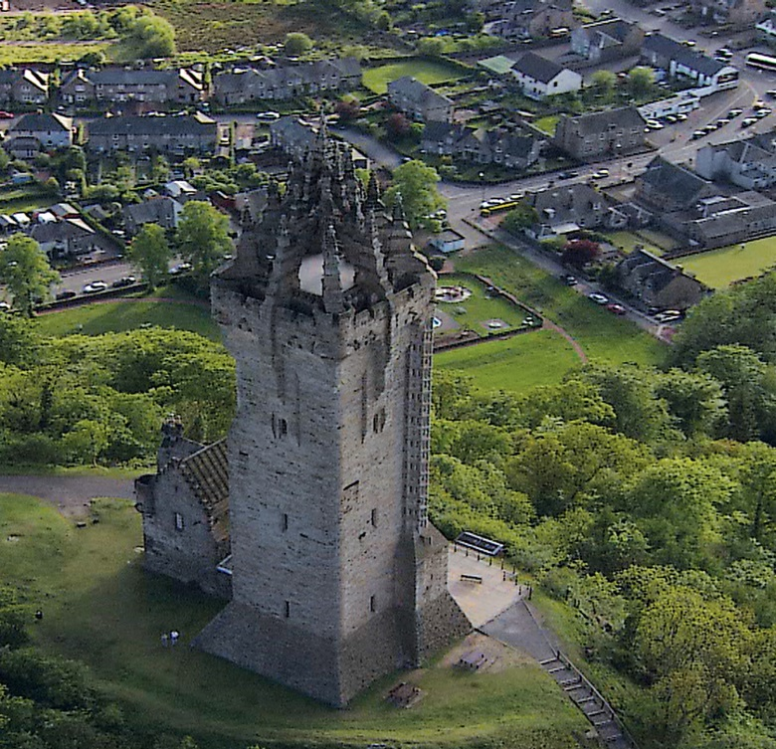
Edinburgh Castle
Wallace Monument
Stirling Castle

Slide 25
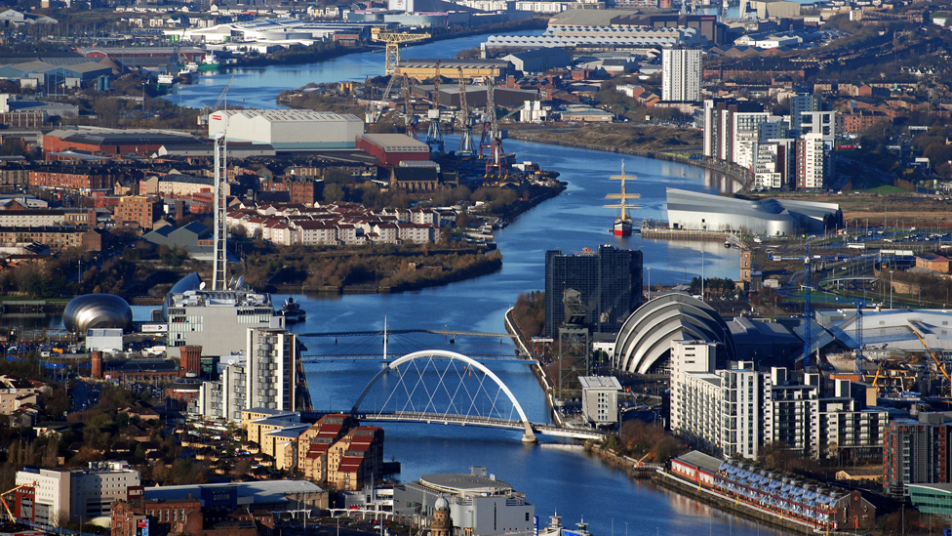
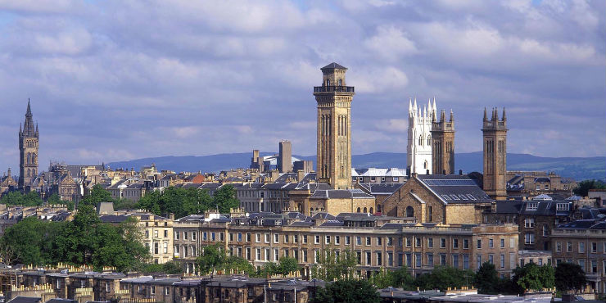
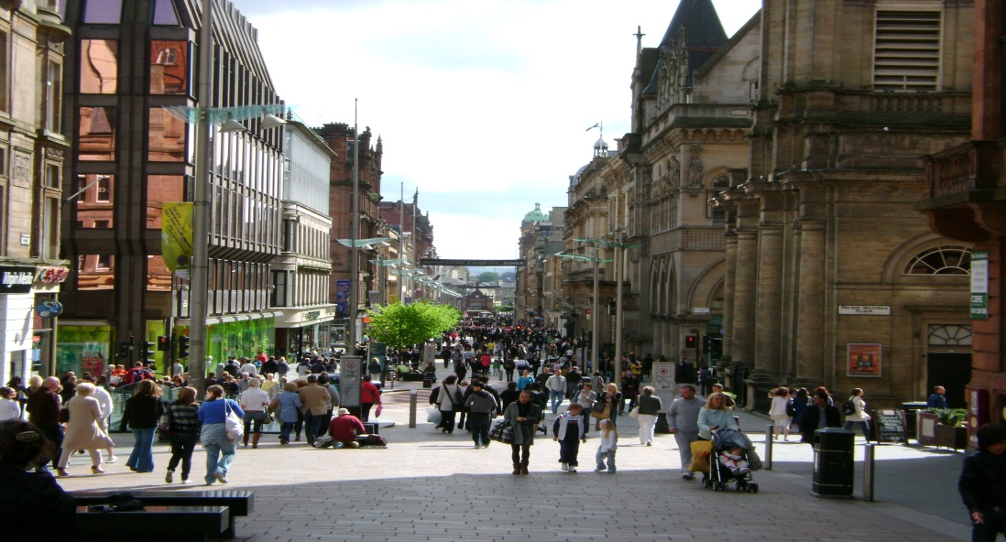
Glasgow

Slide 26
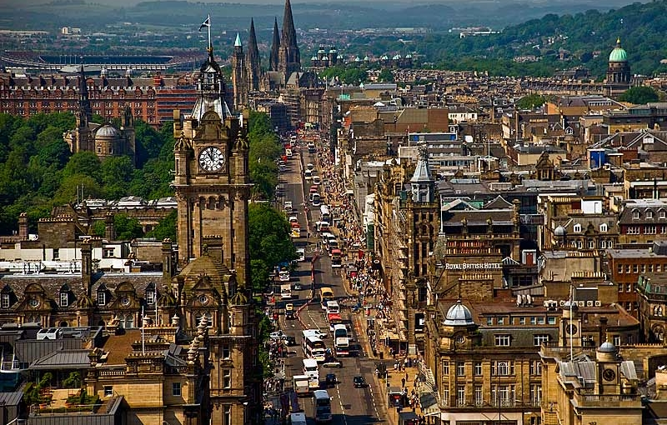
Edinburgh

Slide 27
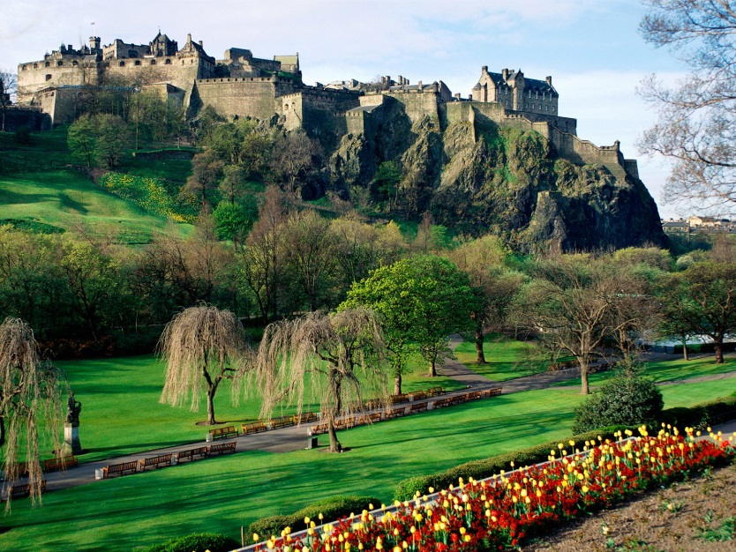
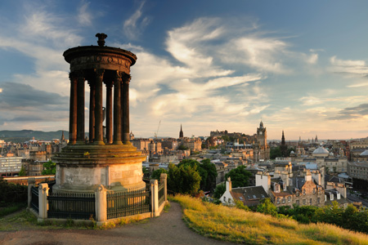
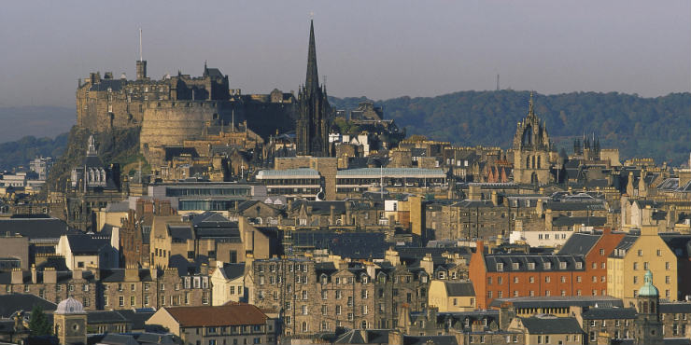
Edinburgh

Slide 28
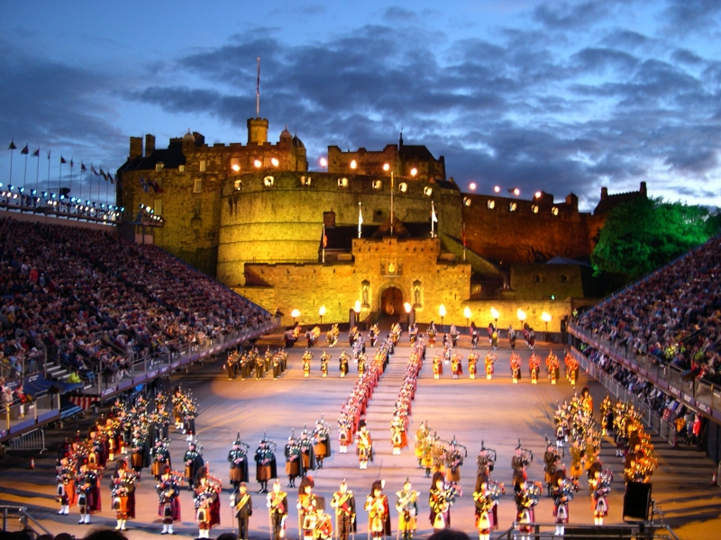
Edinburgh Tattoo

Slide 29
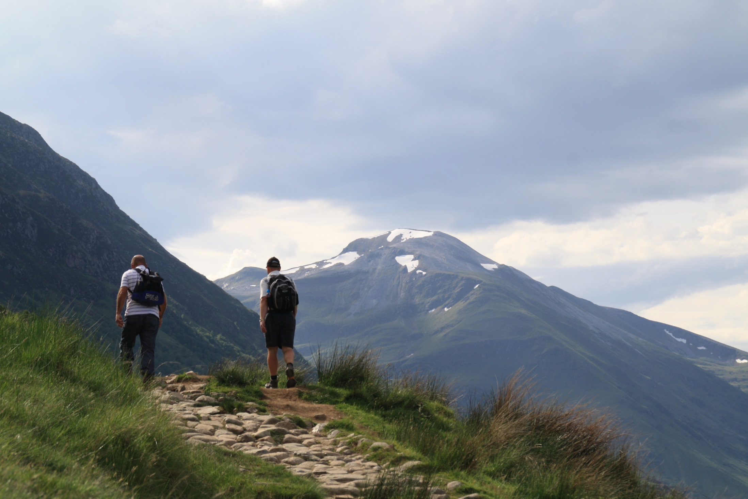
Ben Nevis

Slide 30
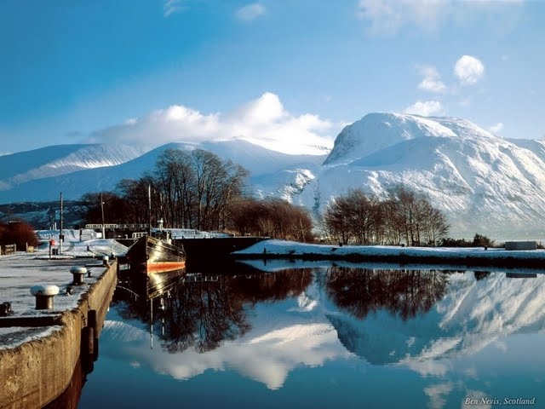
Ben Nevis

Slide 31
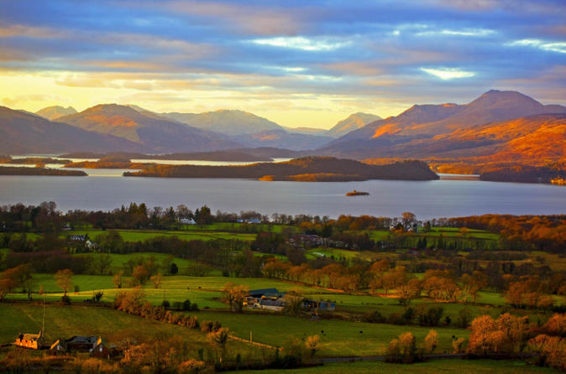
Loch Lomond

Slide 32
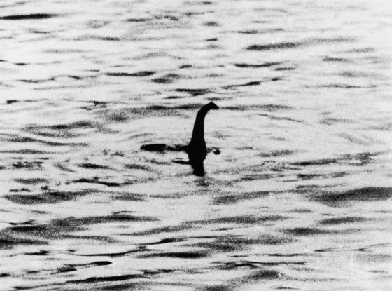
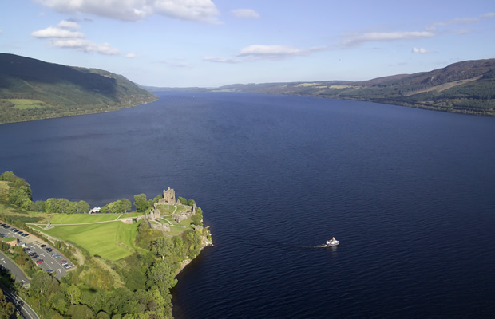
Loch Ness and Nessie

Slide 33
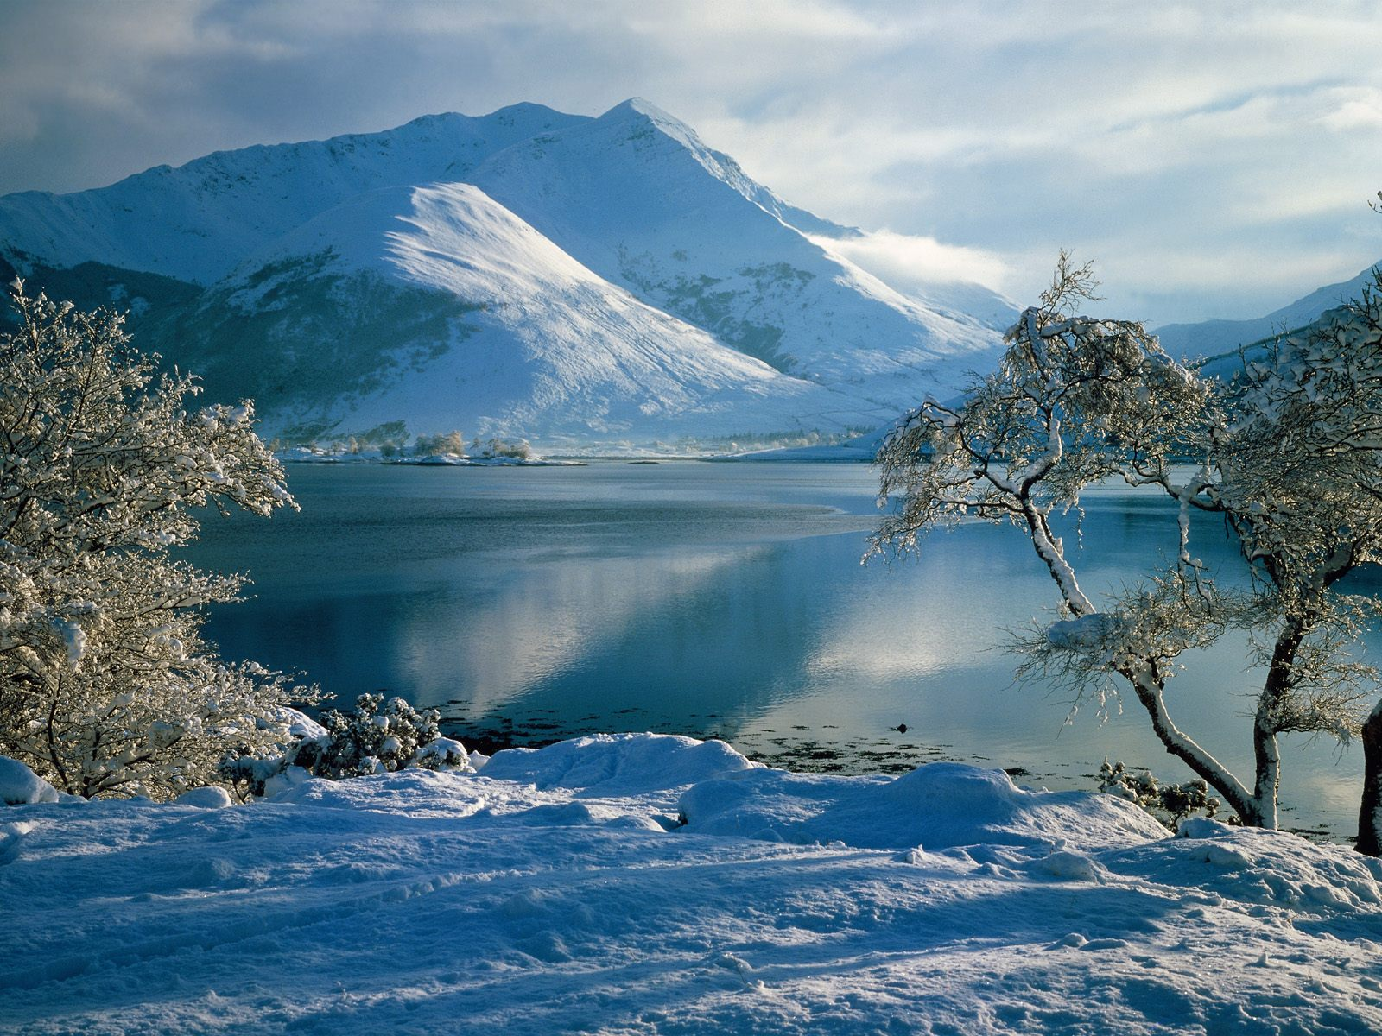
Ballachulish

Slide 34
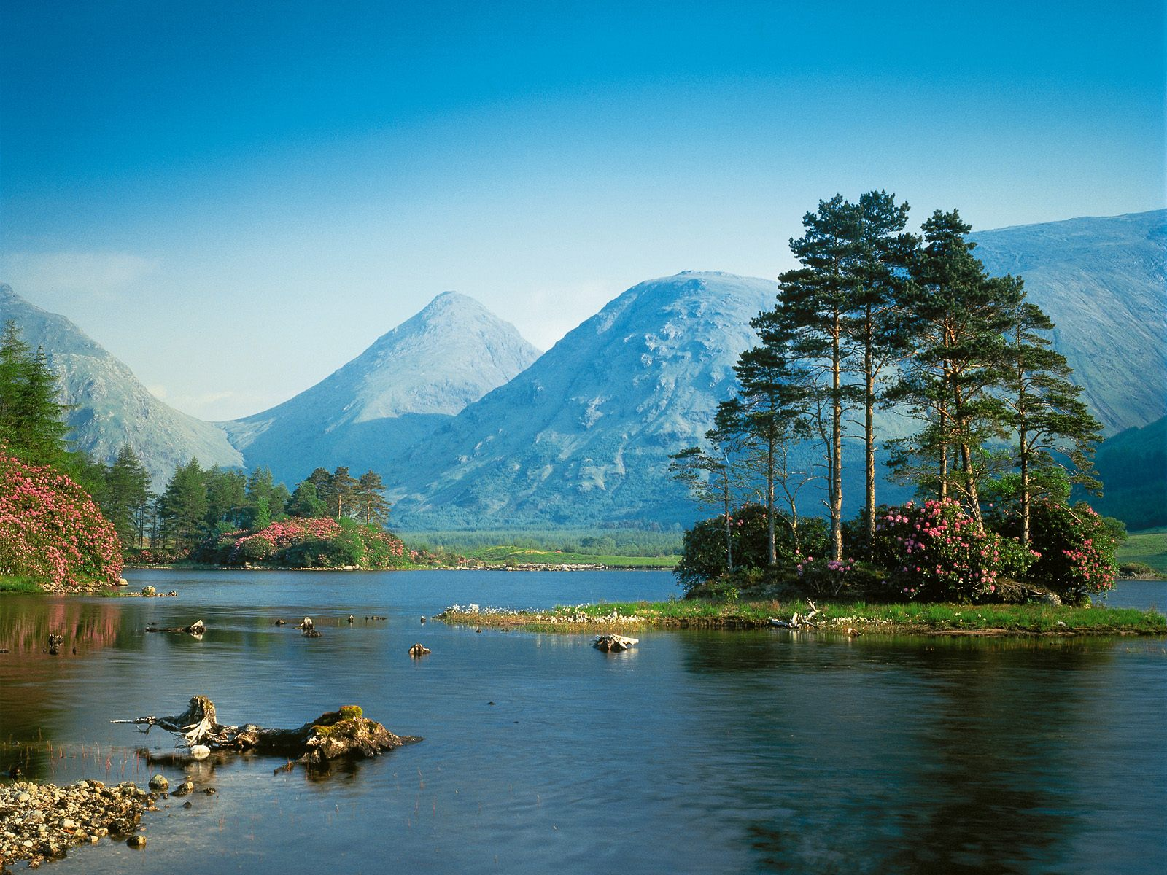
Glen Etive

Slide 35
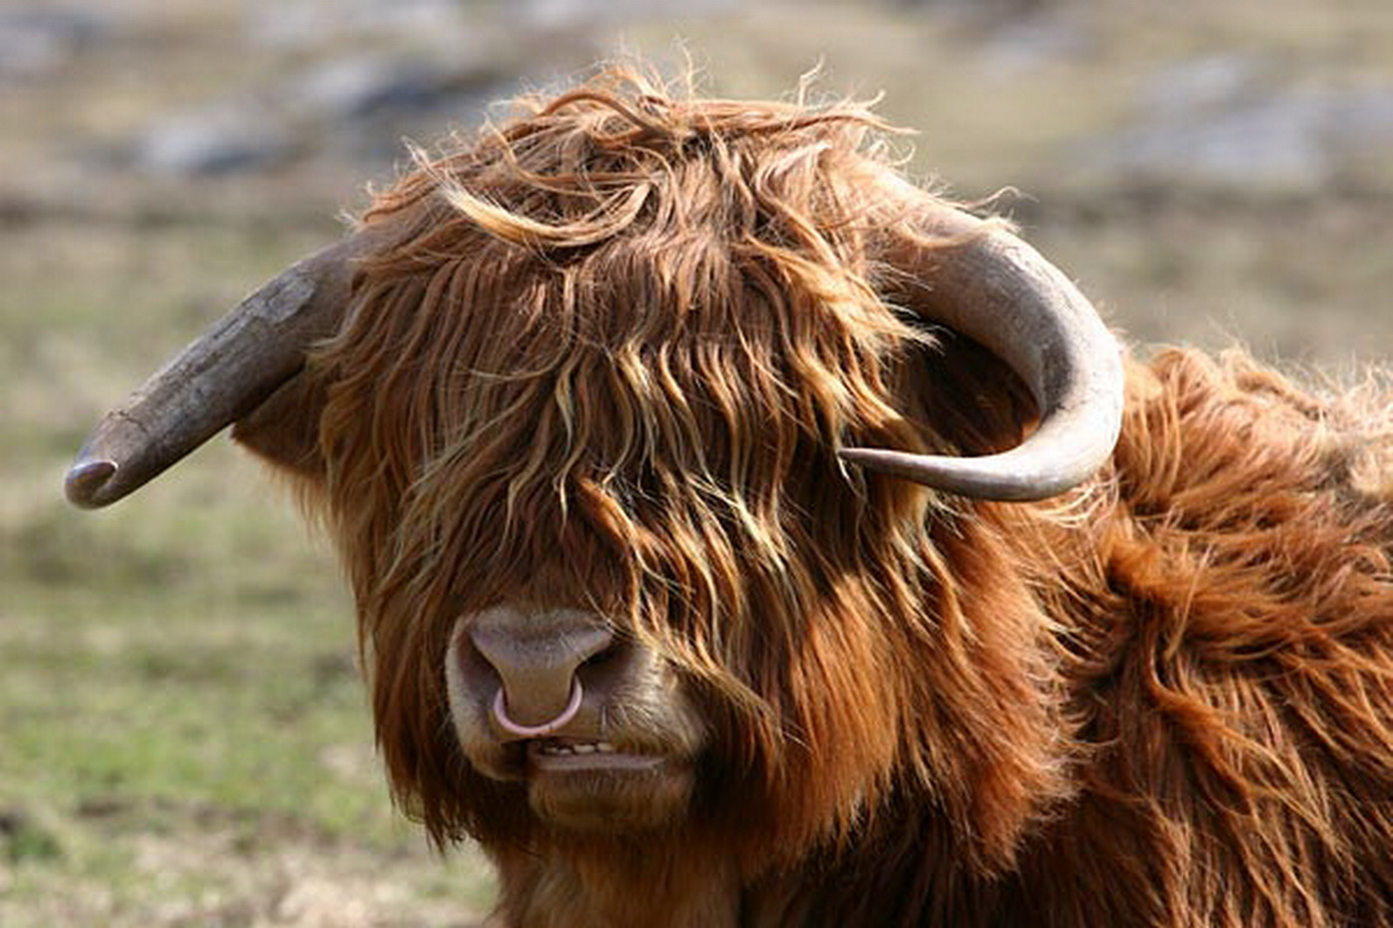
Highland Cattle

Slide 36
Scotland quiz
What is the capital of Scotland?
What is the largest city in Scotland?
When did Scotland and England join together?
What is the population of Scotland?
Name two famous Scottish football teams.
What is the highest mountain in Scotland?
How many islands does Scotland include?
Name three Scottish traditions.
How big is Scotland?
Name these Famous Scottish people.

Slide 37
Scotland Quiz - Answers
Edinburgh
Glasgow
1707 Act of Union(Scotland, England, Wales) to make Great Britain
5.3m in 2011
Glasgow Celtic and Glasgow Rangers.
Ben Nevis 1,344 metres or 4,409 feet
Over 700 islands
Wearing the Kilt, playing Bagpipes and eating Haggis
78,772 km² or 30,414 square miles

Slide 38
10. Name these People
Sean Connery - James Bond
Evan McGregor
James McAvoy
Andy Murray
Sir Alex Ferguson
Sir Chris Hoy

Slide 39
Scottish Slang/Language

Slide 40
Scottish/English words
Aboot About
Agin Against
Ain Own
Auld Old
Bairn Child
Ben Mountain
Burn Stream
But and Ben Cottage
Dram Small quantity of whisky
Dreich Miserable, cold and wet

Slide 41
Scottish/English words
Glaiket Stupid, glazed (expression)
Glen Valley
Gloaming Dusk
Kirk Church
Laddie Boy
Lassie Girl
Spurtle Wooden Spoon
Wain Child
Wee Small
Wheesht! Quiet

Slide 42
Scottish Dancing
Gay Gordon
Strip the Willow
Dashing White Sergeant

