Slide 1
Autumn Festivals in the West
Jane Coates 2014

Slide 2
Diwali-a Hindu and Sikh festival of light

Slide 3
Diwali

Slide 4
A Jewish Festival-a festival of light

Slide 6
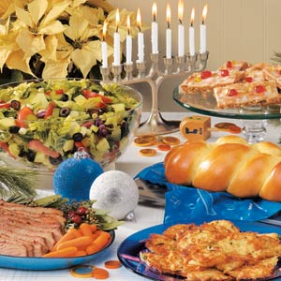
Hanukah

Slide 8
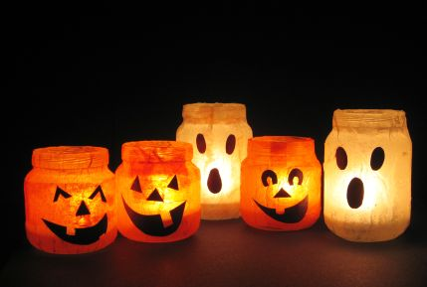

Slide 9
Halloween costumes

Slide 10
Harvest Festival?
Harvest Festival is a celebration of the food grown on the land.
Thanksgiving ceremonies and celebrations for a successful harvest are both worldwide and very ancient. In Britain, we have given thanks for successful harvests since pagan times. We celebrate this day by singing, praying and decorating our churches with baskets of fruit and food in a festival known as 'Harvest Festival', usually during the month of September.

Slide 11
Harvest Festival reminds Christians of all the good things God gives them. This makes them want to share with others who are not so fortunate. In schools and in Churches, people bring food from home to a Harvest Festival Service. After the service, the food that has been put on display is usually made into parcels and given to people in need.

Slide 12
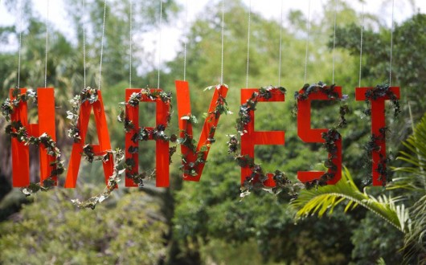
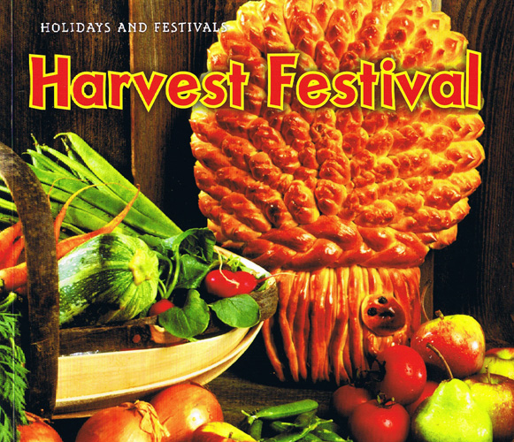
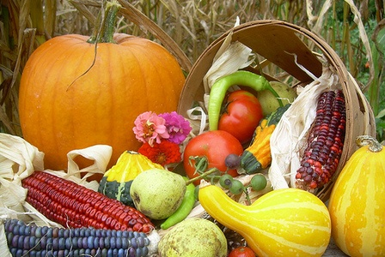

Slide 13
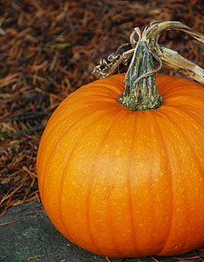
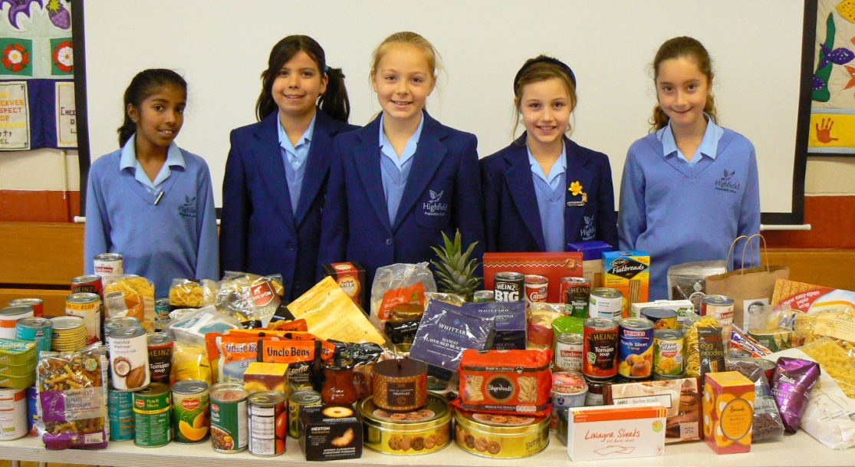

Slide 15
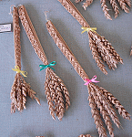
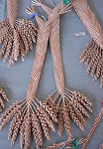
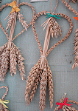
Corn dollies
The making of corn dollies goes back many thousands of years. It was a Pagan custom and evolved from the beliefs of the corn growing people who believed in the Corn Spirit.

Slide 16
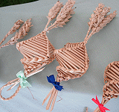
What were corn dollies traditionally made from?
Corn dollies were made at Harvest time from the last sheaf of corn cut.

Slide 17
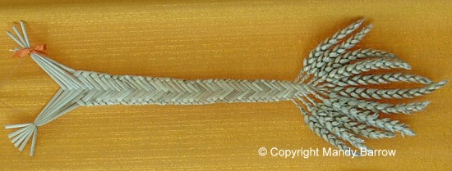
The Corn Spirit was supposed to live or be reborn in the plaited straw ornament or corn doll and was kept until the following spring to ensure a good harvest. The corn dolly often had a place of honour at the harvest banquet table.

Slide 18
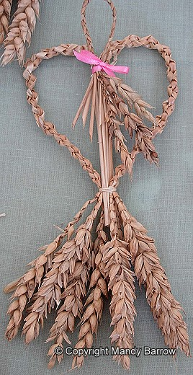
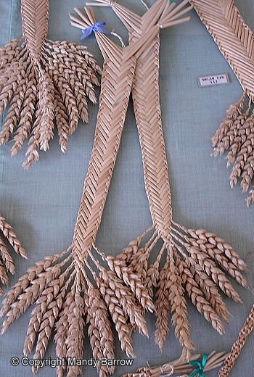

Slide 19
Conkers
During the months of September and October, a favourite playground game is conkers
Britain is believed to be the only country in the world where the game of conkers is played with horse chestnuts in the autumn.
The conker is a hard brown nut which is found in a prickly casing.
The green outer casing of the seed will turn brown and crack open revealing the conkers inside.
They fall from the tree when they are ripe during the autumn months.

Slide 20
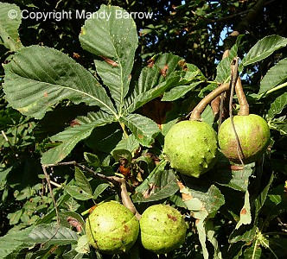
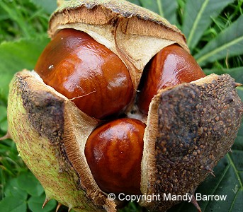
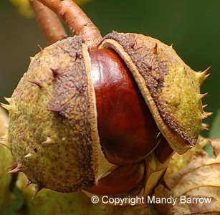
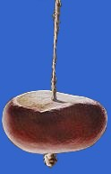

Slide 21
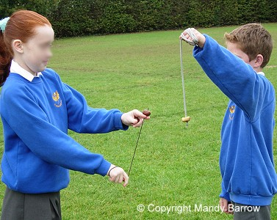
Conkers for playing
The best conkers to play with are uncracked, firm and symmetrical.
Make a hole through the middle of of your chosen conker.
Thread a strong piece of string about 25cm long, through the hole and tie a knot at one end, so that it doesn't pull through.

Slide 22
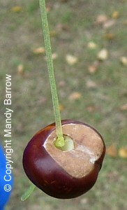
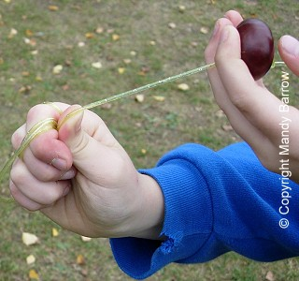

Slide 23
How to play conkers?
Each player has a conker hanging on its string. Players take turns at hitting their opponent's conker.
If you are the one whose conker is to be hit first, let it hang down from the string which is wrapped round your hand. The conker is held at the height your opponent chooses and is held perfectly still.
Your opponent, the striker, wraps his conker string round his hand just like yours. He then takes his conker in the other hand and draws it back for the strike.

Slide 24
Releasing the conker he swings it down by the string held in the other hand and tries to hit his opponents conker (yours) with it.
If a player misses hitting his/her opponents conker they are allowed up to two further goes.
The game goes on in turns until one or other of the two conkers is completely destroyed.

Slide 25
Hints on how to make your conkers harder.
Soak your conker in vinegar.
Bake your conker in the oven.
Use an old conker from previous years.

